Slide 1
Between-Groups ANOVA
Chapter 12

Slide 2
Quick Test Reminder
One person = z score
One sample with population standard deviation = z test
One sample no population standard deviation = single t-test
One sample test twice = paired samples t
Two samples = independent t

Slide 3
Quick Distributions Reminder
z = distribution of scores
z = distribution of means (for samples)
t = distribution of means (for samples with estimated standard deviation)
t = distribution of mean differences (for paired samples with estimated standard deviation)
t = distribution of differences between means (for two groups independent t)

Slide 4
Notes:
What is this?

Slide 5
So what now?
We could do lots of independent t-tests
Group 1 versus Group 2
Group 1 versus Group 3
Group 2 versus Group 3
(that’s too easy though)

Slide 6
Why not use multiple t-tests?
The problem of too many t tests
Fishing for a finding
Problem of Type I error (alpha)
New type 1 error rate = 1 – (1-alpha)^{c}
We want Type I error rate to stay at .05
Notes:
What is the little c?

Slide 7
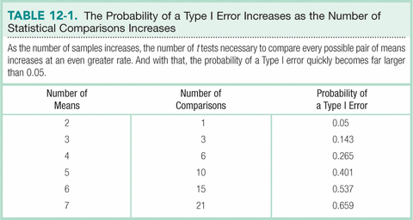

Slide 8
So what do we do?
When to use an F distribution
Working with more than two samples
ANOVA
Analysis of Variance
Used with two or more nominal independent variables and an interval/ratio dependent variable

Slide 9
Types of ANOVA
One-Way: hypothesis test including one nominal variable with more than two levels and a scale DV
Within-Groups: more than two samples, with the same participants; also called repeated-measures
Between-Groups: more than two samples, with different participants in each sample

Slide 10
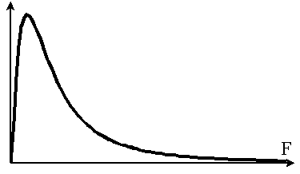
The F distribution
Notes:
What the heck is this?

Slide 11
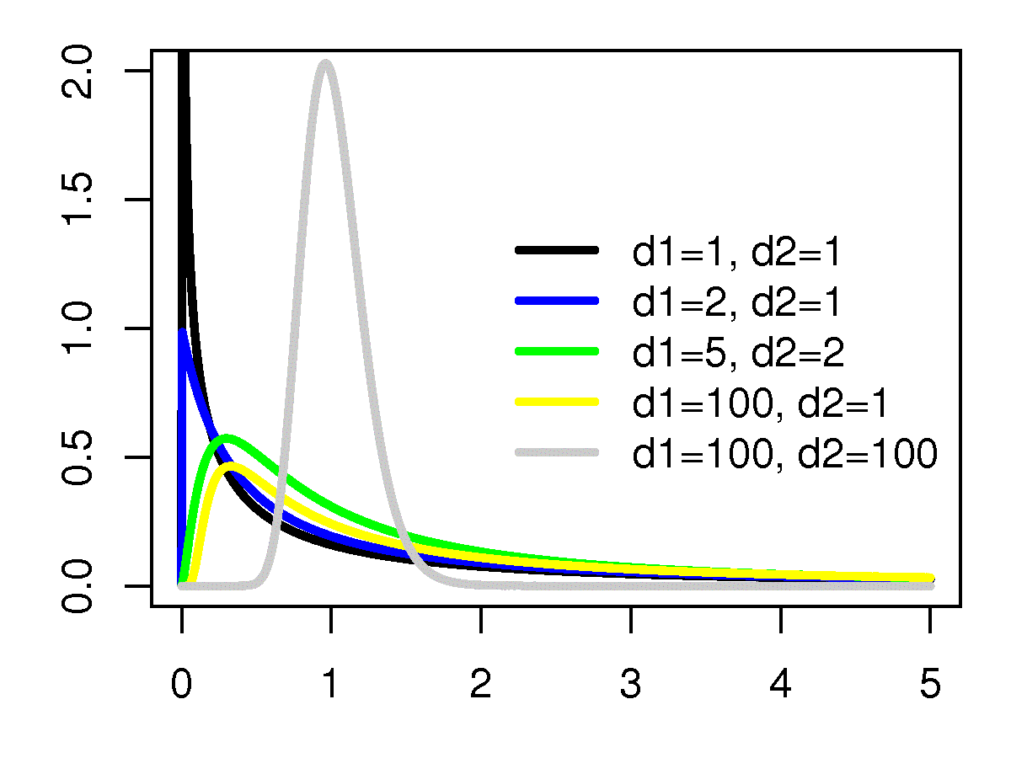
The F distribution

Slide 12
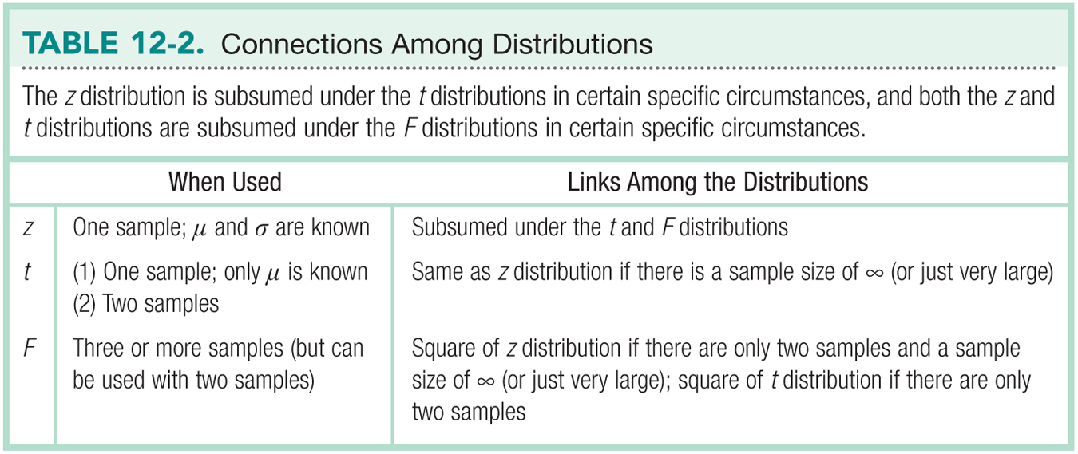

Slide 13
Let’s talk about test statistics
Test type | Formula
Z | M – μ_{M} σ_{M}
Single t | M – μ_{M} s_{M}
Paired t | M s_{M}
Independent t | M – M s_{difference}
Now what do we do with 3 or more Ms and SDs?

Slide 14
The F Distribution
Analyzing variability to compare means
F = variance between groups
variance within groups
That is, the difference among the sample means divided by the average of the sample variances

Slide 15
Logic behind the F Statistic
Quantifies overlap
Two ways to estimate population variance
Between-groups variability
Within-groups variability

Slide 16
Types of Variance
Between groups: estimate of the population variance based on differences among group means
Within groups: estimate of population variance based on differences within (3 or more) sample distributions

Slide 17
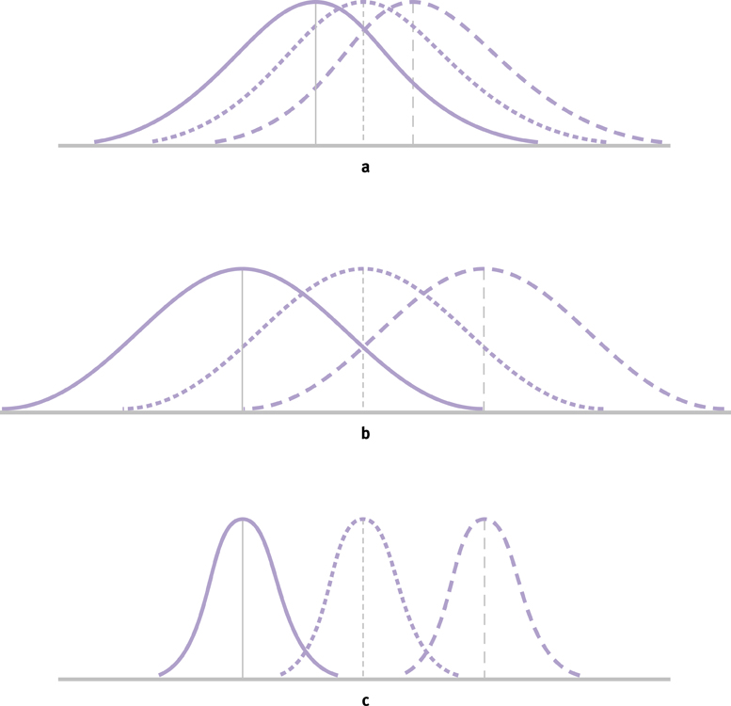
The Logic of ANOVA

Slide 18
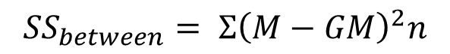
Formulae
$${SS}_{between}= Σ{\left(M−GM\right)}^{2}n$$
Notes:
GM = grand mean
SS between = good variance
SS within = bad variance
MS = mean square

Slide 19
The Source Table
Presents important calculations and final results in a consistent, easy-to-read format

Slide 20
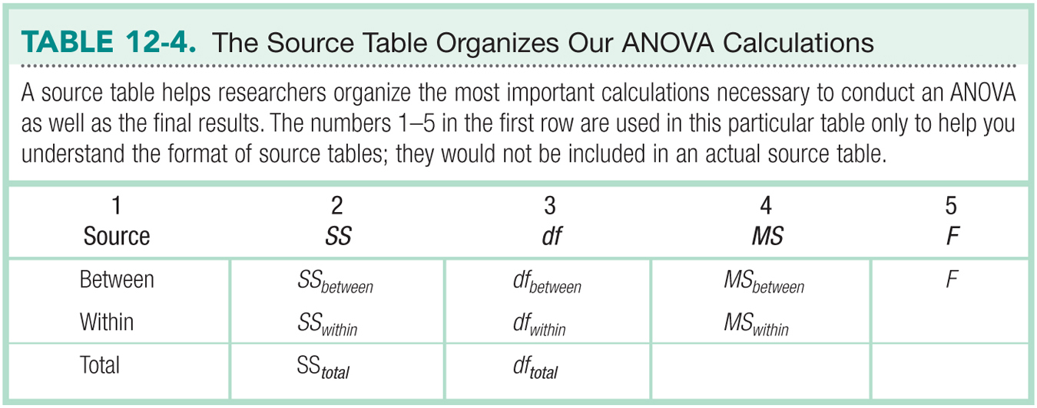

Slide 21
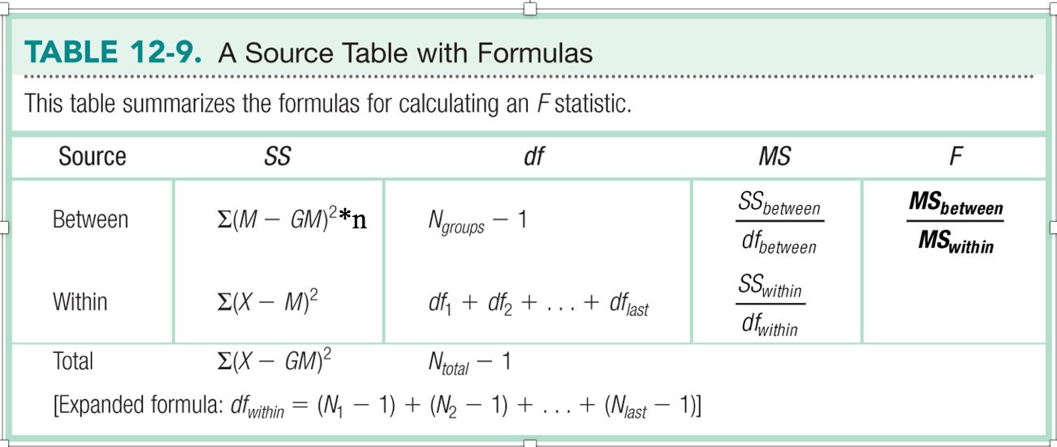

Slide 22
Sum of Squares Example
Let’s try calculating SS within and SS between.
Load the chapter SS example data in JASP

Slide 23
Sum of Squares Example
SS total:
Each person minus grand mean, squared, and summed
The logic here is overall variance, both due to your IV and error will be calculated

Slide 24
Sum of Squares Example
SS within:
The difference of each person minus their group mean, squared
That’s the top half of the variance equation
The logic here is that we don’t know why people differ within their own group, so it’s considered error

Slide 25
Sum of Squares Example
SS between:
Each group minus the grand mean, squared, times N, and totaled.
Why times N?
Every other formula is for each person, so we need to do this one for each person as well
The logic here is to measure how much of the overall variance is IV group differences (good variance), not individual differences (bad variance)

Slide 26
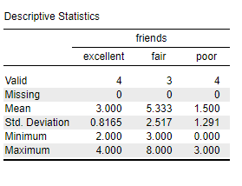
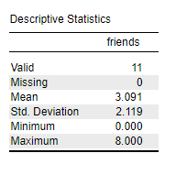
Sum of Squares Example
To do this in JASP, start by calculating the means for each group by running descriptives for the DV split by group (picture on left; this will give group means) and then descriptives for the DV not split by group (picture on right; this will give your grand mean):

Slide 27
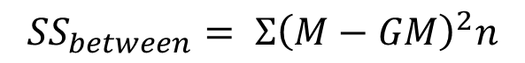
SS between
(3.00 – 3.09)^2 * 4 +
(5.33 – 3.09)^2 * 3 +
(1.50 – 3.09)^2 * 4
0.03 + 15.05 + 10.11 = 25.19
$${SS}_{between}= Σ{\left(M−GM\right)}^{2}n$$

Slide 28
SS within
Excellent M = 3.00
(4-3)^2 + (3-3)^2 + (2-3)^2 + (3-3)^2 = 1 + 0 + 1 + 0 = 2
Fair M = 5.33
(3-5.33)^2 + (5-5.33)^2 + (8-5.33)^2 = 5.43 + 0.11 + 7.13 = 12.67
Poor M = 1.50
(3-1.5)^2 + (1-1.5)^2 + (0-1.5)^2 + (2-1.5)^2 = 2.25 + 0.25 +2.25 + 0.25 = 5
SS within = 2 + 12.67 + 5 = 19.67

Slide 29
Variance Type | SS | df | MS | F
Between groups (IV) | 25.19
Within Groups (error) | 19.67
Total | 44.86

Slide 30
Let’s talk about df
Test type | df
Single sample t | N – 1
Paired samples t | N – 1
Independent t | N – 1 + N – 1

Slide 31
Degrees of Freedom for ANOVA

Slide 32
Variance Type | SS | df | MS | F
Between groups (IV) | 25.19 | 2
Within Groups (error) | 19.67 | 8
Total | 44.86 | 10

Slide 33
Variance Type | SS | df | MS | F
Between groups (IV) | 25.19 | 2 | 12.60
Within Groups (error) | 19.67 | 8 | 2.46
Total | 44.86 | 10 | XX

Slide 34
Variance Type | SS | df | MS | F
Between groups (IV) | 25.19 | 2 | 12.60 | 5.12
Within Groups (error) | 19.67 | 8 | 2.46 | XX
Total | 44.86 | 29 | XX | XX

Slide 35
One-Way Between-Groups ANOVA
Everything about ANOVA but the calculations
1. Identify the populations, distribution, and assumptions.
2. State the null and research hypotheses.
3. Determine the characteristics of the comparison distribution.
4. Determine the critical value, or cutoff.
5. Calculate the test statistic.
6. Make a decision.

Slide 36
Assumptions of ANOVAs
Random selection of samples
DV is scale
No outliers for any group
Normally distributed sample
Homoscedasticity: samples come from populations with the same variance
Generally this is referred to as homogeneity

Slide 37
Null and Research Hypotheses
ONLY us = and ≠
Why?
Example:
Research: cheese ≠ candy ≠ fruit
Null: cheese = candy = fruit
Notes:
Why? Because we’re just trying to see if there are differences between any of the groups or not.

Slide 38
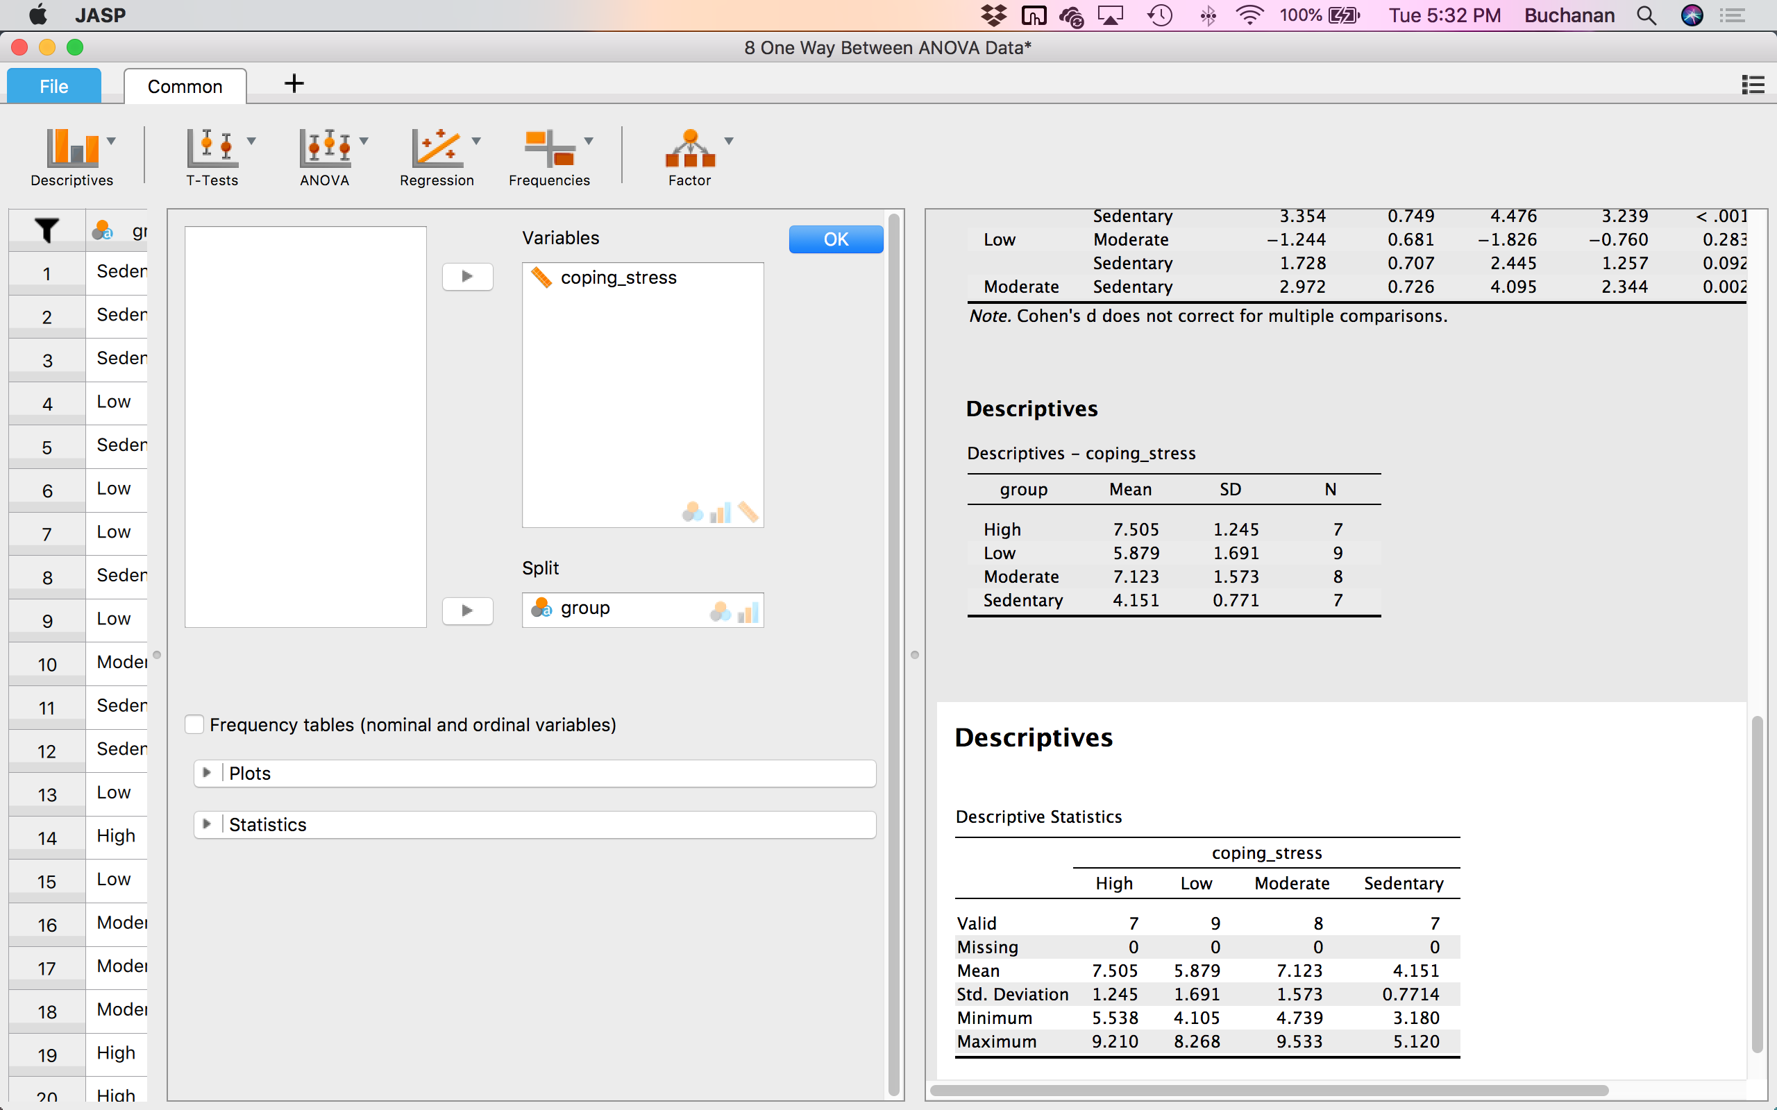
How to JASP
Is the dependent variable at least scale (ratio or interval)?
Are there any outliers in the sample?
1) Show the distribution of scores of the DV for each level of the IV (split on IV and make a histogram)

Slide 39
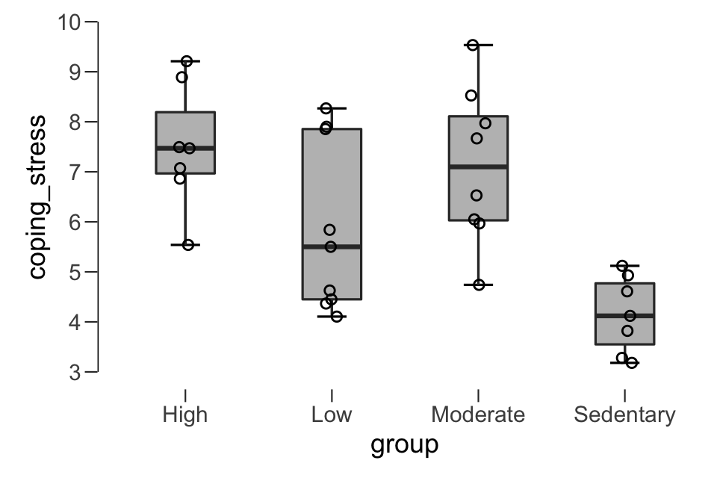
How to JASP
Are there any outliers in the sample?
2) See if any of the scores are really far away from the mean (make a boxplot that’s split by group)
Boxplots → Label Outliers → Jitter Element

Slide 40
How to JASP
Is the dependent variable normally distributed?
Use a Shapiro-Wilk test
T-Tests → One Sample T-Test → move DV into Variables box (don’t split by the levels of IV) → Assumption Checks → Normality
If p > .05 that means the data is normal
Write-up:
The assumption of normality was met, assessed by a Shapiro-Wilk test, p = .215
Test of Normality (Shapiro-Wilk)
 |  | W |  | p
coping_stress |  | 0.955 |  | 0.215
Note. Significant results suggest a deviation from normality.

Slide 41
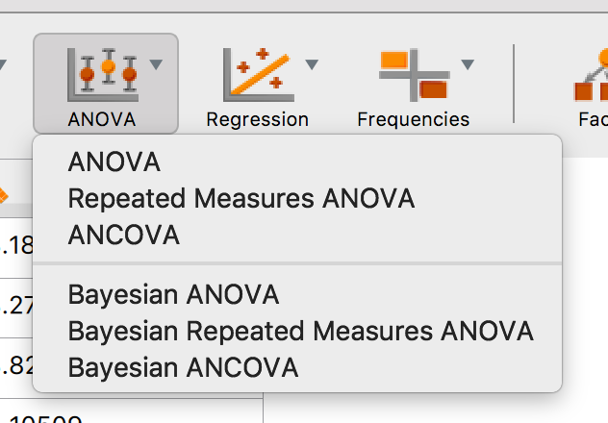
How to JASP
Do you have homogeneity of variances?
To get this analysis, we will run the ANOVA and get Levene’s test
ANOVA → ANOVA (the one that just says “ANOVA” is the between subjects ANOVA)

Slide 42
How to JASP
Homogeneity of variances cont…
Move the IV (the one with groups) into the “Fixed Factors” box
Move the DV into the “Dependent Variable” box
Click on “Assumption Checks” → Homogeneity Tests
Your output should look something like this:
If Levene’s test has a p > .05, this is good! That means you have equal variances (you meet the assumption of homogeneity of variances)

Slide 43
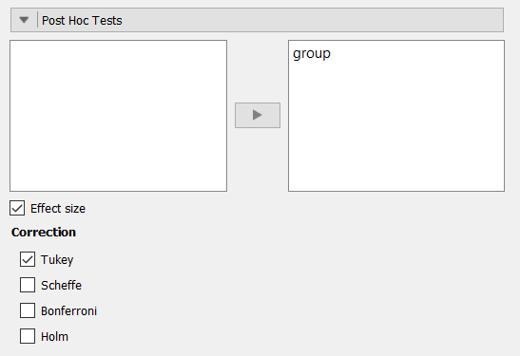
How to JASP
Finishing out the ANOVA (run post hoc tests)
Post Hoc Tests → Move group over to the right → Click on “Effect size”
We are going to use “Tukey” correction for our tests, so select that under the Correction Section

Slide 44
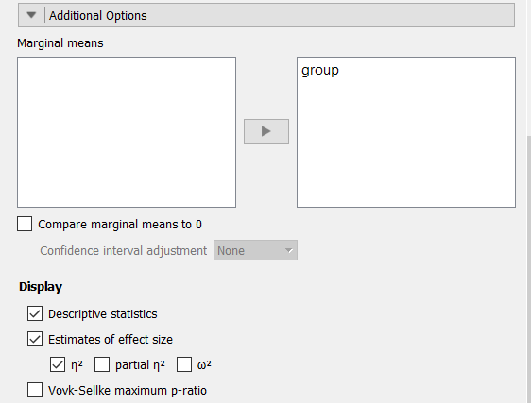
How to JASP
Finishing out the ANOVA
Additional Options → under Marginal Means, move the IV (the ones with the groups)
Under Display, select “Descriptive statistics”, “Estimates of effect size”, and η² (eta squared) or ω² (omega squared)
*we will use η² (eta squared)

Slide 45
Interpreting & Reporting
Your ANOVA output should look something like this:
If the ANOVA is statisticaly significant (p < .05), that means at least one group mean is different from another
If the ANOVA results in a p > .05, that means there is not statistically significant difference in the means
Write the results up like this:
F(df1, df2) = F value, p = p value, effect size = effect size value
F(3,27) = 8.32, p < .001, η² = .48

Slide 46
Effect Sizes
η² (eta squared) is a common measure of effect size for ANOVAs
Gives us the amount of variance due to the IV out of the total (estimates how much the difference is across all the groups)
Used to determine the amount of variance accounted for (out of 100% variance) that the IV explains in the DV
You should only get values 0-1 for η² because it is a proportion
Could say that (η² )% of the variance in the DV is accounted for by the IV
For this example, we could say 48% of the variance in stress coping scores is accounted for by the group variable
Notes:
67.2 / 96.3 = .70

Slide 47
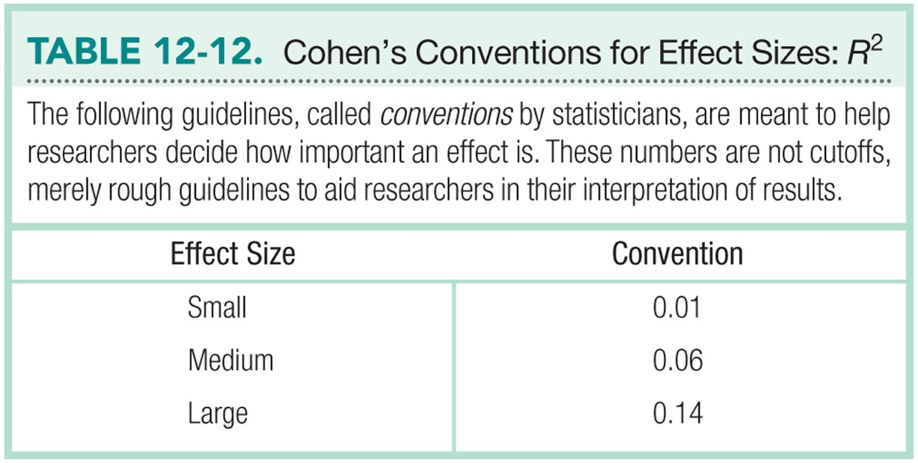

Slide 48
Post-Hoc Tests to Determine Which Groups Are Different
When you have three+ groups, and F is significant, how do you know where the difference(s) are?
Run post hoc tests!
t tests to compare two groups at a time
End up with one test for each possible combination of two groups
Run a post hoc correction
Tukey (*we will use this)
(other types: Bonferroni, Scheffe, etc.)

Slide 49
Important Note
Post hoc tests
Make sure the post hoc tests you run match the type of research design
For a between subjects ANOVA, JASP will automatically run independent t tests as the post hoc tests for the between subjects ANOVA
Post hoc corrections (like Tukey)
Solve our Type I error problem

Slide 50
Interpreting & Reporting
Since our ANOVA was significant, we ran post hoc tests (with Tukey corrections) to see which groups were different
Here are our results for each of the post hoc tests:

Slide 51
Interpreting & Reporting
Interpreting what the columns indicate:
Mean Difference: difference in means of groups
(M _{Group A} – M _{Group B})
SE: standard error of difference between groups
t: independent t-test value for the group comparison
Cohen’s d: Cohen’s d value for the group comparison
p _{Tukey}: Tukey corrected p value for the group comparison
If the p _{Tukey} < .05 that means the difference between those two groups is significant

Slide 52
Interpreting & Reporting
High vs. Sedentary and Moderate vs. Sedentary are significantly different (p < .05)
High vs. Low and Low vs. Sedentary also have large effect sizes
Need to look at both statistical (p value based) and practical (effect size based) interpretations of importance

Slide 53
Interpreting & Reporting
Now that we know which differences are meaningful, we can look at the marginal means and descriptives
Marginal means will should us SE and CIs for each group
Descriptives will show us the M, SD, and N for each group
This tells us which group stored higher on our DV for the group comparisons that were significant

Slide 54
Example Write-up
A one-way ANOVA was conducted to determine if the ability to cope with workplace-related stress (CWWS score) was different for groups with different physical activity levels. Participants were classified into four groups: sedentary (n = 7), low (n = 9), moderate (n = 8) and high levels of physical activity (n = 7). There were no outliers, as assessed by boxplot; data was normally distributed for each group, as assessed by Shapiro-Wilk test (p = .215); and there was homogeneity of variances, as assessed by Levene's test of homogeneity of variances (p = .120). Data is presented as mean ± standard deviation.

Slide 55
Example Write-up Cont.
CWWS score was statistically significantly different between different physical activity groups, F(3, 27) = 8.32, p < .001, η² = 0.48. CWWS score increased from the sedentary (M = 4.15, SD = 0.77) to the low (M = 5.88, SD = 1.69), moderate (M = 7.12, SD = 1.57) and high (M = 7.51, SD = 1.24) physical activity groups, in that order. Tukey post hoc analysis revealed that the mean increase from sedentary to was statistically significant (p = .002, d = 2.34), as well as the increase from sedentary to high (p < .001, d = 3.24), but no other group differences were statistically significant.

Slide 56
Summing it up
In Layman's terms:
CWWS scores for those with low physical activity > CWWS scres for those considered sedentary
CWWS scores for those with high physical activity > CWWS scres for those considered sedentary

